Slide 1

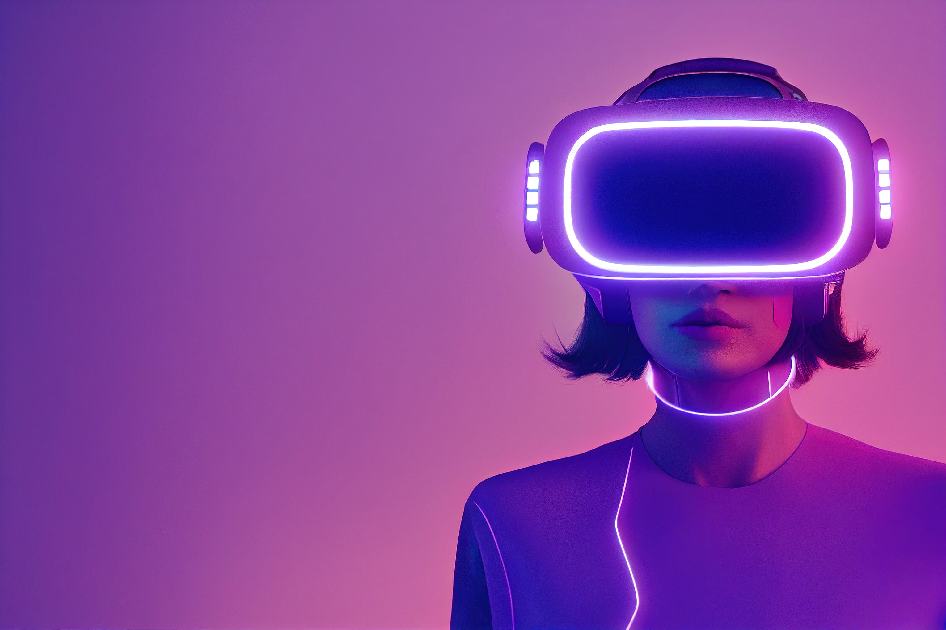

virtual
reality
Let’s start!
Presented by:
Zymonne Ambunan
Xyrille Salas

Slide 2

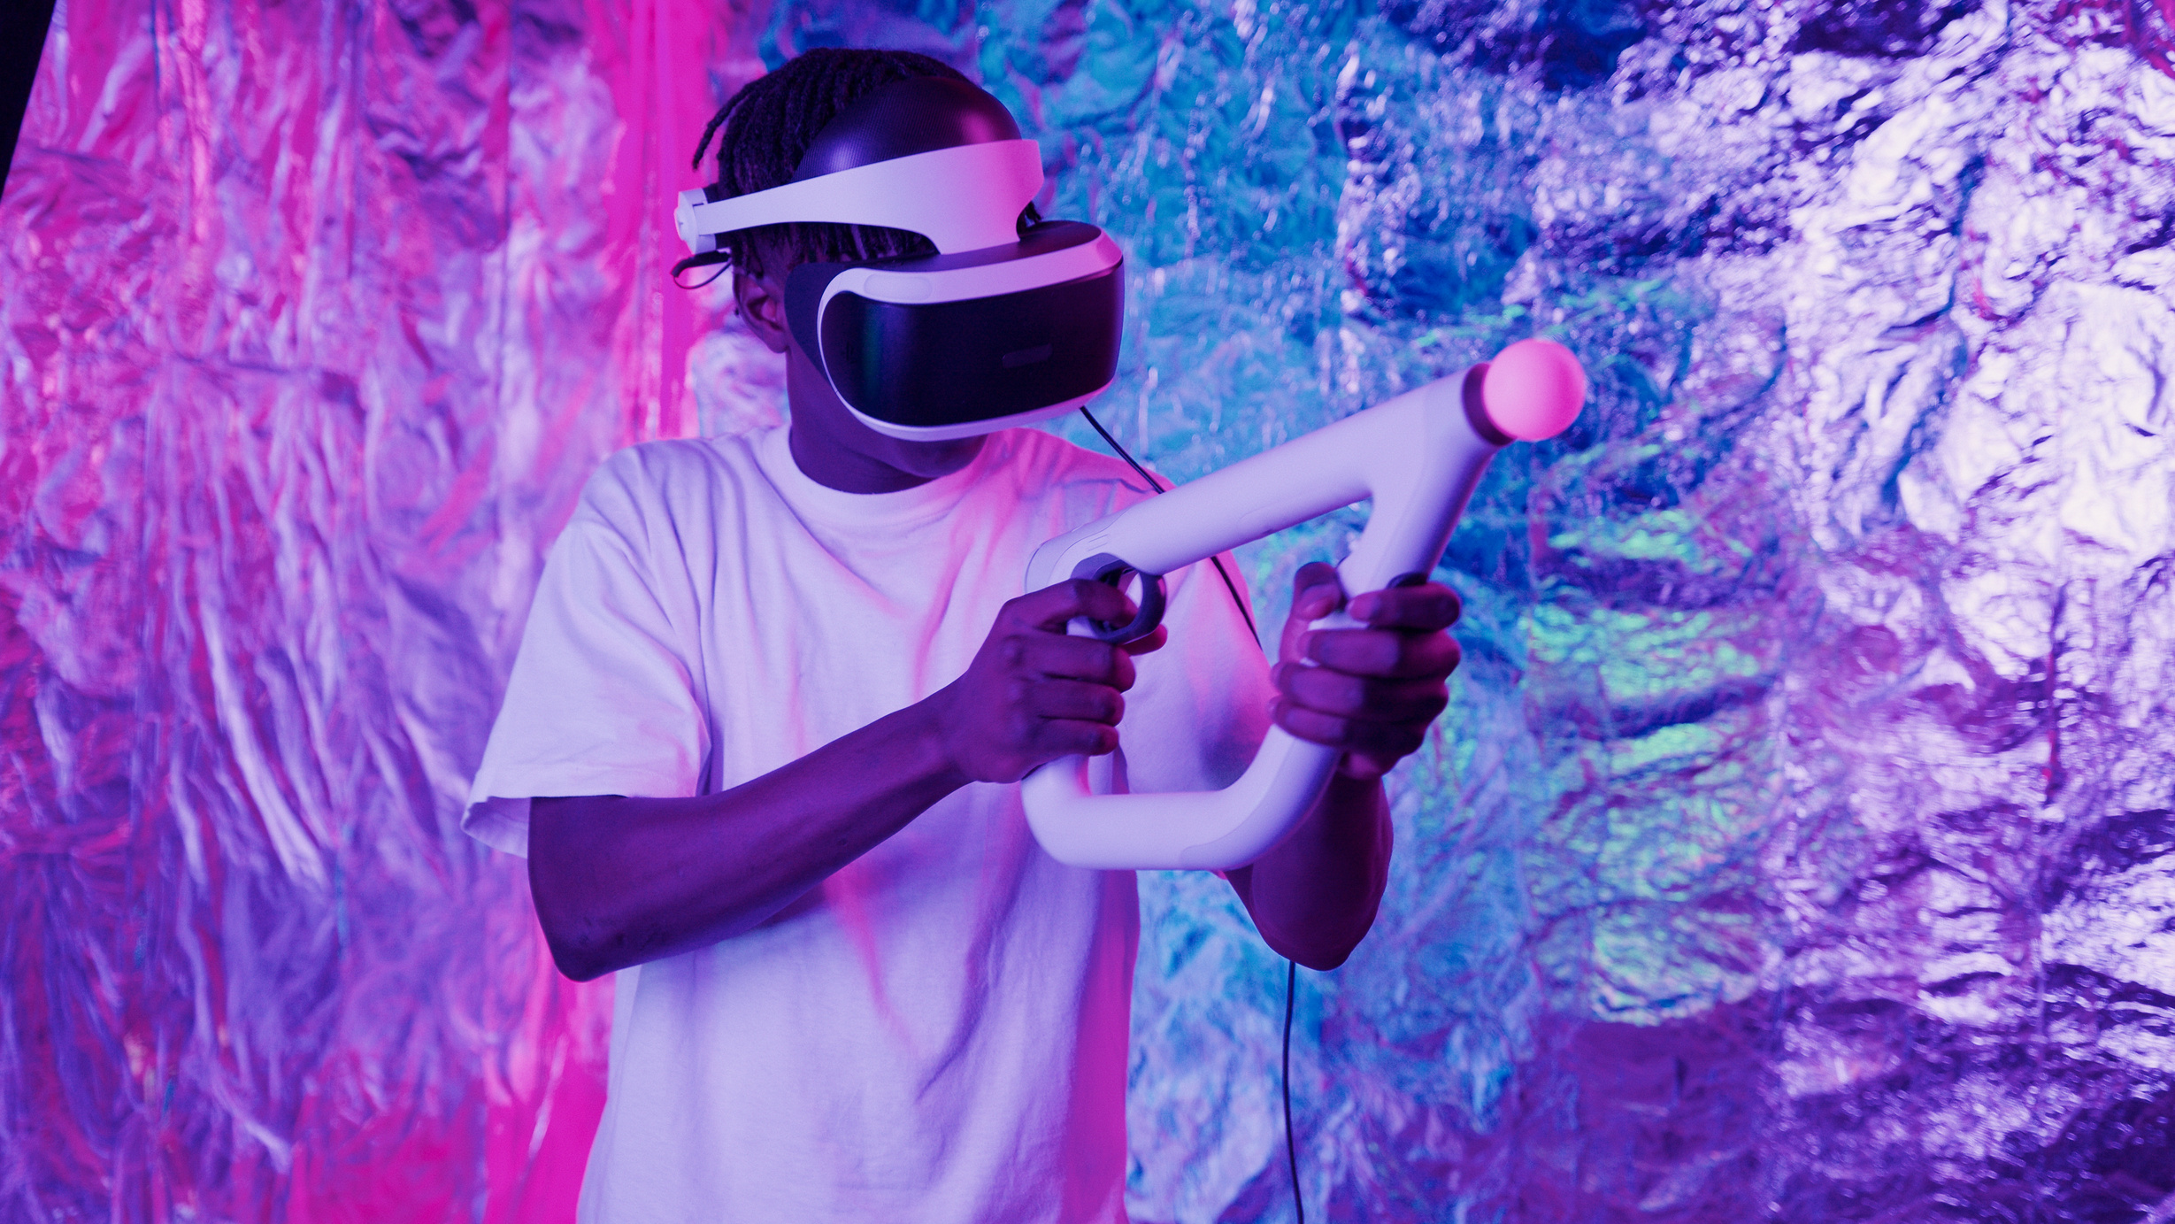
WHAt is tactile
virtual Reality?
Tactile Virtual Reality is an advanced form of Virtual Reality (VR) that integrates the sense of touch into virtual environments.
It enables users not only to see and hear but also to feel virtual objects, textures, surfaces, and forces.
It combines haptic technology, sensory feedback, and physiological measurement techniques to recreate the experience of touch.

Slide 3
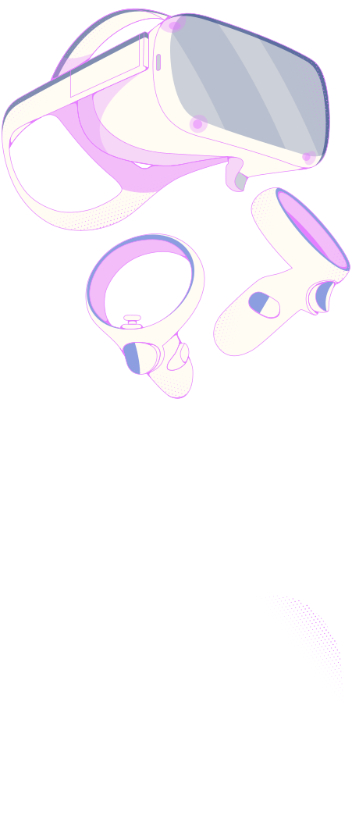
Augmented Reality vs Virtual reality
Foundation Concepts:
Virtual Reality (VR) - Fully computer-generated simulated environment; replaces real world entirely.
Augmented Reality (AR) - Overlays digital information onto the real world.
Tactile VR - Goes beyond sight and sound; adds touch/haptic feedback to VR experiences.

Slide 4
Types of Virtual Reality
Non-Immersive VR - Screen-based; limited interaction; no full immersion.
Semi-Immersive VR - Partial 3D experience; large screens or projection systems.
Fully-Immersive VR - Complete sensory experience via head-mounted displays; Tactile VR falls under this category.

Slide 5
History & Evolution
Evolution of Tactile VR
VR evolved from simple visual-only systems toward multi-sensory experiences.
Tactile/haptic feedback was added later to bridge the gap between seeing and feeling.
Research combined neurophysiology, sensors, and display technologies to recreate touch sensations.

Slide 6

Key Definitions & Terms
Head Mounted Display (HMD) - Wearable device/goggles that place you inside the virtual environment
Haptics - Technology that uses force, vibration, and resistance to recreate the sense of touch
360° Videos - Full spherical view content that allows looking in any direction
Interactive VR - Virtual environment that responds to user actions in real time

Slide 7
Key Definitions & Terms
Stereoscopy - Technique for creating or enhancing the illusion of depth in an image
4D Virtual Reality - VR that includes environmental effects beyond 3D (including tactile/touch)
Field of View (FOV) - The extent of the observable virtual world seen at any given moment
Simulator Sickness - Discomfort, dizziness, or nausea experienced by some VR users

Slide 8
Key Definitions & Terms
Image/Video Stitching - Combining multiple images into one seamless panoramic view.
Cave Automatic Virtual Environment (CAVE) - Room-sized VR projection system.
Mixed Reality - Merging real and virtual worlds where physical and digital objects coexist.

Slide 9

Neurophysiologic Measurement Techniques
Electroencephalography (EEG)
Magnetoencephalography (MEG)
Functional Magnetic Resonance Imaging (fMRI)
Measures brain electrical activity; tracks cognitive response to tactile stimuli.
Measures magnetic fields produced by brain activity; higher precision.
Detects blood flow changes in the brain; maps which areas respond to touch.

Slide 10

Somatosensation
The Science Behind Touch
Somatosensation - the body's ability to perceive touch, pressure, temperature, pain, vibration, and position.
Tactile VR works by recreating signals that the body naturally interprets as "touch."

Slide 11
Two Types of Somatosensation
1. Active Somatosensation
  User initiates contact — reaching out, touching, grasping virtual objects.
  Brain interprets what is felt based on movement + sensory feedback.
2. Passive Somatosensation
  Something contacts the user — virtual object pushes, presses, or touches the user.
  Body receives sensation without initiating movement.

Slide 12
How Tactile VR Works
User interacts with virtual environment via HMD and haptic devices.
System tracks position, movement, and contact points.
Haptic feedback generated - force, vibration, texture, temperature signals.
User feels the sensation through gloves, controllers, or body suits.
Brain accepts the combined sight + sound + touch as a realistic experience.

Slide 13

Core Enabling Technologies
Haptic feedback devices - gloves, controllers, actuators
Sensory sensors - pressure, vibration, temperature detectors
Motion tracking systems - detect position and movement in 3D space
High-speed processing — renders visuals + calculates touch feedback in real time

Slide 14
Real-World Applications: Video Games
Feel weapon recoil, impacts, textures, and surface resistance.
Interact physically with game environments - feel water, fire, fabric, metal.
Immersion level drastically increases compared to visual-only VR.

Slide 15
Applications: Education & Training
Medical training - practice procedures, feel tissue resistance without risk.
Engineering & maintenance - learn to handle machinery; feel parts and connections virtually.
Dangerous environments - train for hazardous situations safely.

Slide 16
Applications: Product Development
Prototype virtually — feel and test product designs before physical manufacturing.
Test ergonomics, shape, surface texture, and grip digitally.
Saves cost, time, and materials in design process.

Slide 17

Advantages of Tactile VR
Adds the missing sense - Touch completes the human sensory experience in VR.
More immersive & realistic - Sight + Sound + Touch = deeper immersion.
Safer training - Practice high-risk tasks virtually first.
Enhanced learning - Hands-on experience improves knowledge retention.
New ways to create & design - Feel your ideas before building them

Slide 18
Challenges & Limitations
Simulator Sickness — Some users experience dizziness, eye strain, or nausea.
Complex Technology — Requires integration of displays, sensors, haptics, and tracking.
Hardware Constraints — Current devices are bulky, heavy, or expensive.
Not Perfect Yet — Recreating every texture and sensation with 100% realism remains a challenge.

Slide 19
Technical Challenges
Accurately recreating all texture types (rough, smooth, soft, hard, sticky).
Simulating temperature changes and heat transfer.
Latency — feedback must be instant; delay breaks realism.

Slide 20

Tactile VR & Cybersecurity Connection
Tactile VR expands the cyber attack surface.
Haptic devices, sensors, and connected systems create new security risks.
If tactile signals can be manipulated remotely - fake sensations could be forced on users.
Securing VR/haptic infrastructure is critical as technology advances.

Slide 21
Future of Tactile VR
Lighter, wireless haptic gear - more comfortable, less restrictive.
Higher realism - finer textures, precise temperature, realistic force feedback.
Wider adoption - medicine, education, entertainment, engineering.
Securing VR/Integration with other tech - AI, IoT, 5G/6G for remote tactile experiences.haptic infrastructure is critical as technology advances.

Slide 22
References
Thakur, K., Pathan, A.S.K., & Ismat, S. (2023).
Emerging ICT Technologies and Cybersecurity: From AI and ML to Other Futuristic Technologies.
Springer Nature Switzerland AG.
Tactile Virtual Reality

Slide 23
Thank
you!

